Slide 1

Capstone Project Presentation
Kohsin Chen
Zerui Zhang
Zheng Zhang
Bingshen Yang
Greenspace Mental Health
Group 3
Therapeutic Alliance
May 28, 2024

Slide 2

Agenda
01
02
03
04
05
06
Intoduction
Objectives &
Motivation
Data &
Data Cleaning
Models & Prelimiary Result
Summary
Next Steps

Slide 3

Introduction

Slide 4

What is Therapeutic Alliance (TA)?
collaborative and affective bond between a therapist and a patient
plays a pivotal role and predictor in the efficacy of psychological treatments

Slide 5
Literature Review
01
Therapeutic alliance as a consistent predictor of successful treatment outcomes [1]
02
Personalized matching significantly improves psychotherapy outcomes compared to traditional assignment methods [2]
03
Key factors : empathy, agreement on therapy goals, and mutual collaboration
References:
Ardito,R.B.,&Rabellino,D.(2011).Therapeuticallianceandoutcomeof psychotherapy: historical excursus, measurements, and prospects for research. Frontiers in Psychology, 2, 270.
Martin,D.J.,Garske,J.P.,&Davis,M.K.(2000).Relationofthetherapeutic alliance with outcome and other variables: A meta-analytic review. Journal of Consulting and Clinical Psychology, 68(3), 438.

Slide 6

Therapeutic Alliance Assessment
(BR-WAI)
My therapist and I understand each other.
We have established a good understanding of the kind of changes that would be good for me.
1 = Strongly Disagree
2 = Disagree
3 = Neutral
4 = Agree
5 = Strongly Agree
I feel that my therapist appreciates me.
I believe the time my therapist and I are spending together is not spent efficiently.
I believe my therapist likes me.

Slide 7
GreenSpace Mental Health
Comprehensive Measurement Based Care (MBC) platform tailored for mental health professionals and clients.
Measurement-Based Care involves tracking client progress throughout treatment, using consistent Patient-Reported Outcome Measures (PROMS).

Slide 8
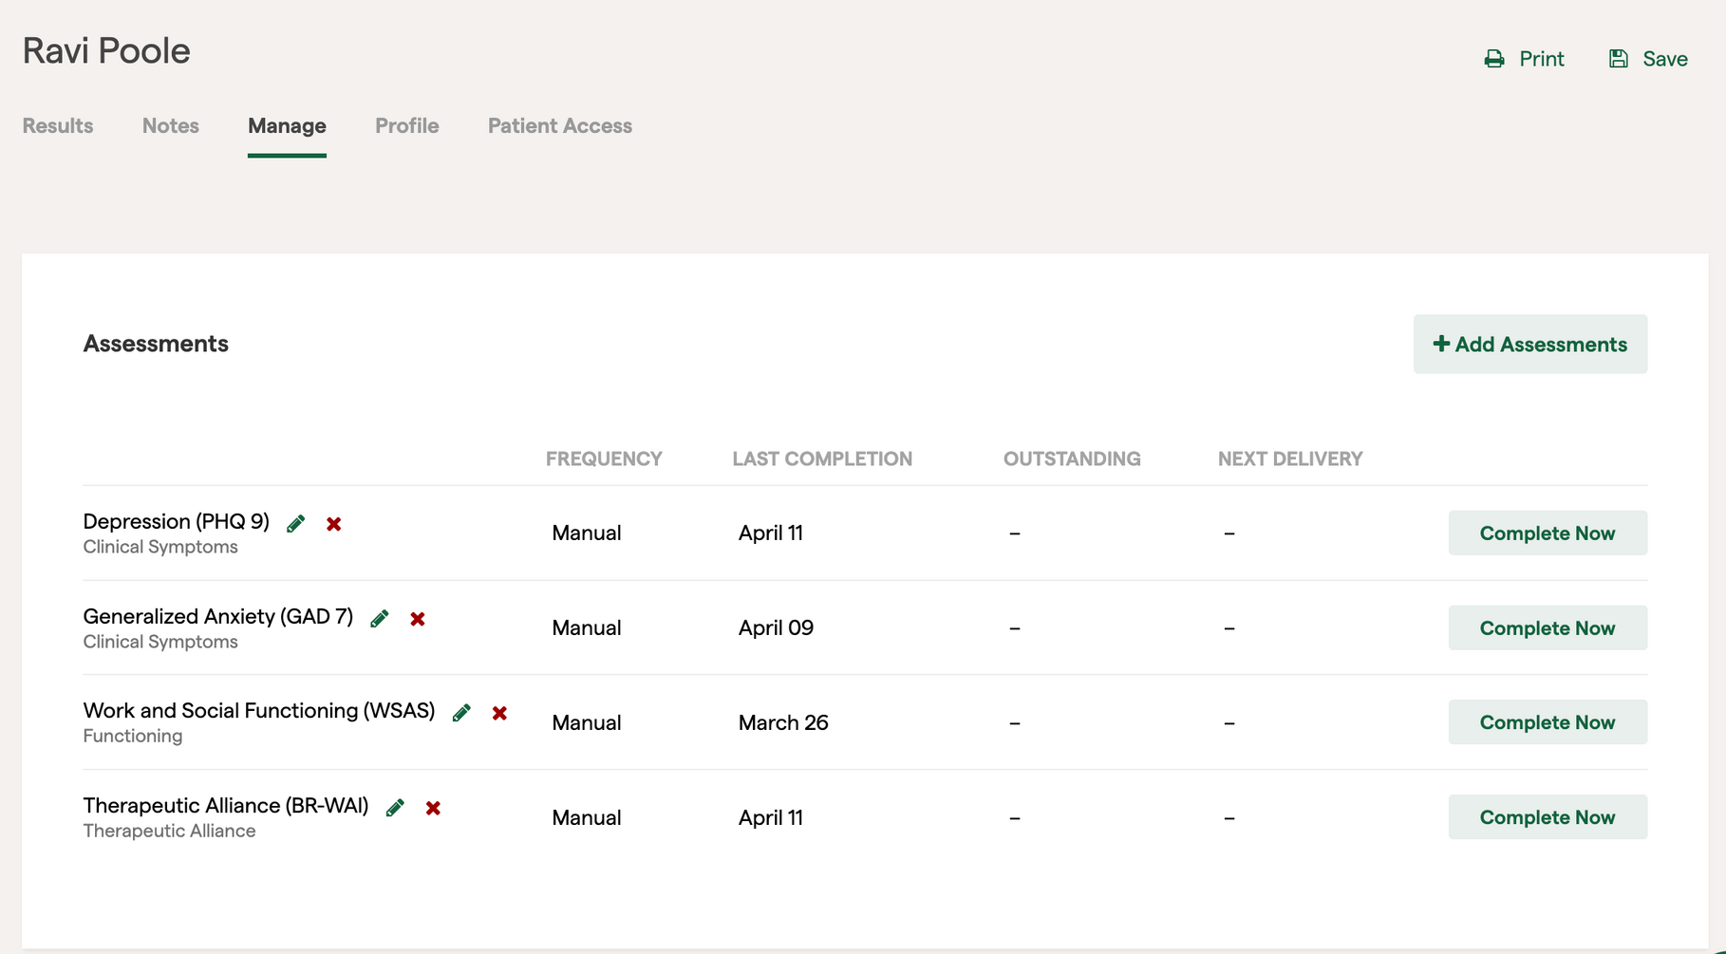
Demo

Slide 9
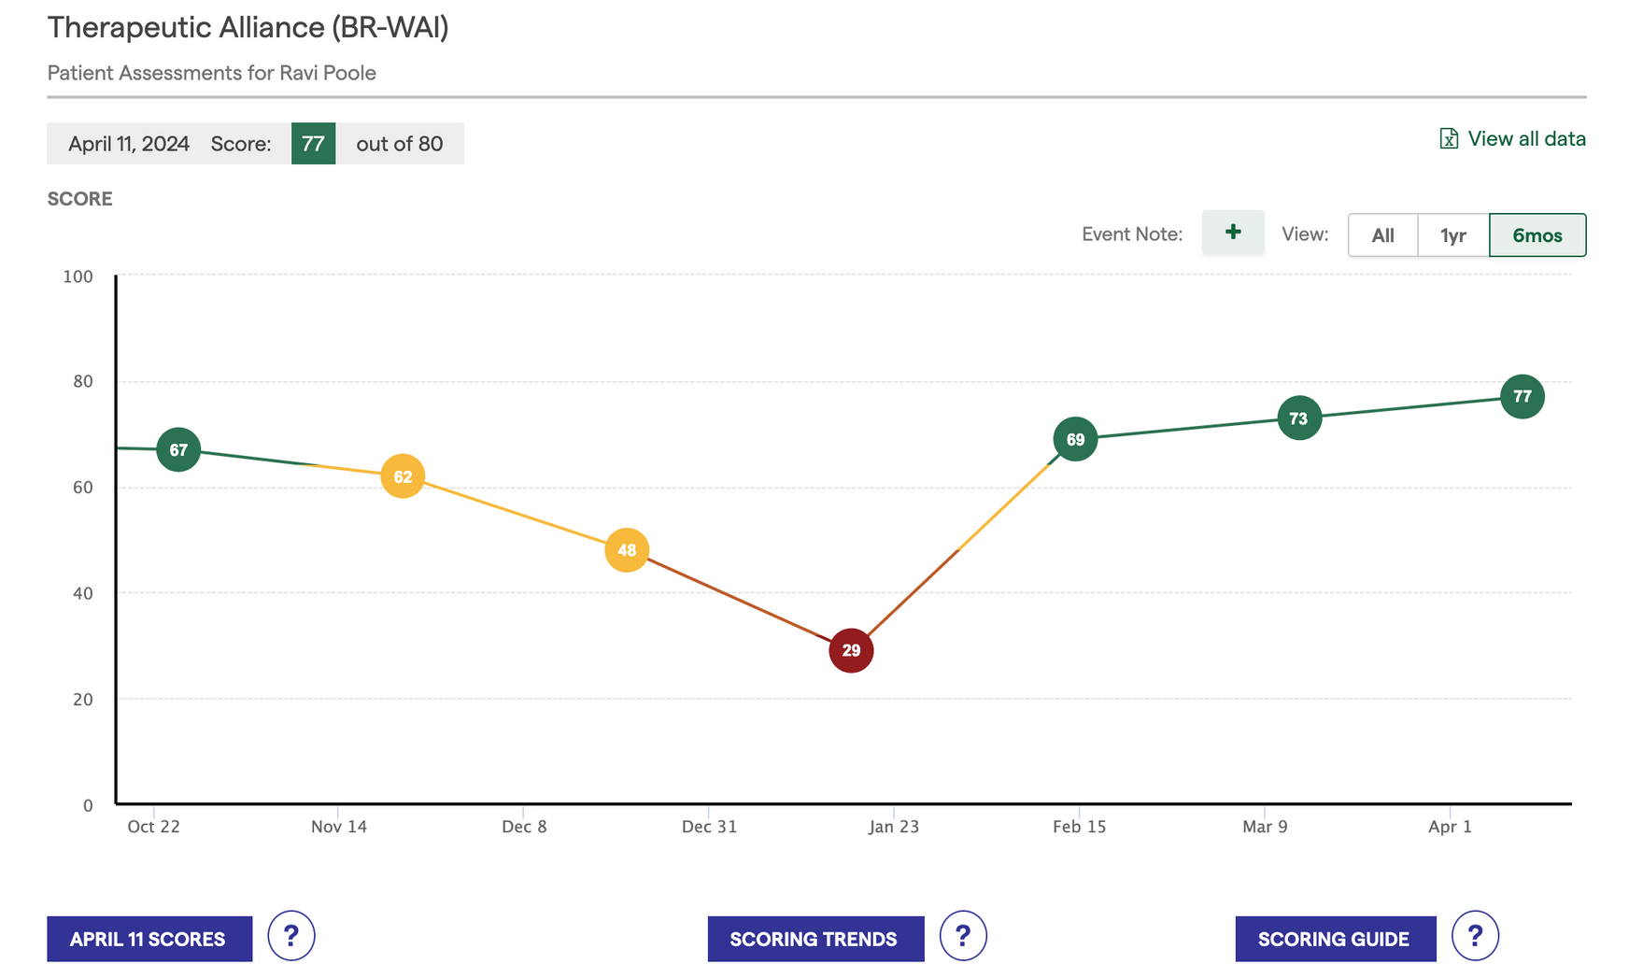
Demo

Slide 10
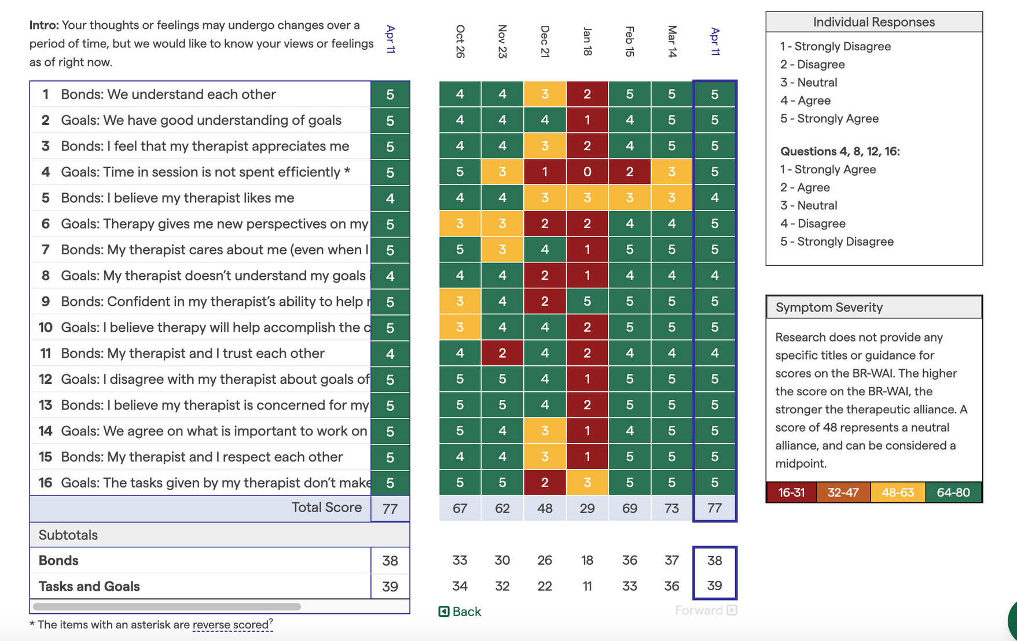
Demo

Slide 11
Research Question & Motivation

Slide 12

What needs to happen for the Therapeutic Alliance score between patient and therapist to be high?
Notes:
The question we are trying to answer is “what needs to happen for the Therapeutic Alliance score between patient and therapist to be high?” This involves identifying and understanding the dynamics and characteristics that foster a strong therapeutic alliance, which is crucial for effective treatment outcomes.
In other words, we need a model that explains the relationship between Therapeutic Alliance scores and factors related to the patient and therapist.

Slide 13
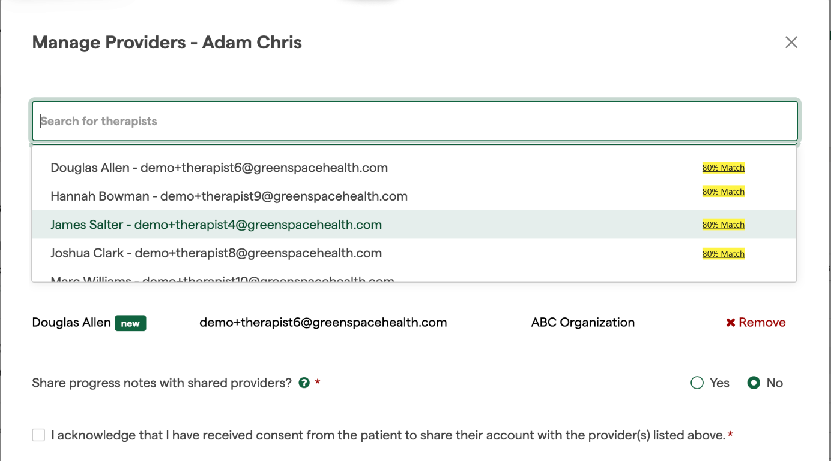
Connecting Patients with likely successful Therapists
Notes:
The ultimate goal of building such model is connecting patients with likely successful therapists. This page is what Greenspace currently have when an intake worker or clinical administrator trying to assign a therapist to a patient, what they don't have is the yellow highlighted match percentage, which will help the administrator assign the right therapist to the patient.

Slide 14
Data &
Data Cleaning

Slide 15
Dataset Overview
15 tables, 260k ~ 20m rows
ASSESSMENTS
ASSESSMENT_ID
PARTICIPANT_ID
DISPLAY_NAME
CODE
...
PATIENTS
PATIENT_ID
PARTICIPANT_ID
THERAPEUTIC_ALLIANCE_SCORE
PATIENT_TYPE
INOFFICE
...
QUESTIONS & RESPONSES
QUESTION_ID
RESPONSE_ID
PATIENT_ID
QUESTION_TITLE
RESPONSES
SCORE_NORMALIZED
SUICIDALITY_FLAG
...
TAGS
TAG_ID
PATIENT_ID
SLUG
...
THERAPISTS
THERAPISTS_ID
THERAPEUTIC_ALLIANCE_SCORE
Notes:
Dataset from Greenspace is extensive, consisting of 15 tables. There are between 260 thousand to 20 million rows of data for each table. This compilation provides imformation into the various aspects of patient assessments, therapeutic sessions, and overall healthcare dynamics.

Slide 16

Identify Predictors
Initial Assessment Scores
Assessment Completed Rate
Patient Demographic
via assessments assigned
via response table
via tags assigned
Treatment Received
via tags assigned
Notes:
Initial Assessment Scores:
We begin with initial assessment scores. These scores serve as a baseline for evaluating the patient's condition at the start of their treatment.
Completed ratio:
This metric helps us gauge patient engagement and adherence to the treatment plan.
Patient Demographic:
The demographic information of patients is another critical factor. We gather this data through various means:
Assessments Assigned: The types of assessments assigned can give clues about the patient's demographic profile.
Response Table: Responses to assessments provide direct demographic data.
Tags Assigned: Tags or labels assigned to patients based on their demographic characteristics help categorize and analyze them effectively.

Slide 17
Assessments as Predictor
Initial Assessment Scores
extract first assessment score by date
average the scores
Assessment Completed Ratio
# completed assessments/ # total assessments
Main Diagnosis
most frequently assessment given for each patient
depression/anxiety/eating disorder/substance addiction/post-traumatic stress disorder etc
challenges
Notes:
Extract First Assessment Score by Date: We extract the first assessment score for each patient based on the date to ensure we are capturing their initial state.
Average the Scores: Additionally, we calculate the average of these scores to understand the general condition of patients at the start.
Assessment Completed Ratio:
Next, we look at the assessment completed ratio. This ratio is calculated by dividing the number of completed assessments by the total number of assessments assigned to each patient.
Main Diagnosis:
Finally, we address the main diagnosis of each patient.
Most Frequently Assigned Assessment: We identify the primary diagnosis by looking at the most frequently given assessment for each patient.
Categories: The main diagnoses we focus on include conditions such as depression, anxiety, eating disorders, substance addiction, and post-traumatic stress disorder, among others.
Identifying the primary diagnosis is arbitrary. Using this method to identify the primary diagnosis might be problematic, but due to the lack of such information in the dataset, it is a necessary compromise. Some assessments are too general to classify the patient. For example, some questionnaires measure daily function, which does not allow for clear classification. As a result, many patients will still have missing values for their main diagnosis.

Slide 18
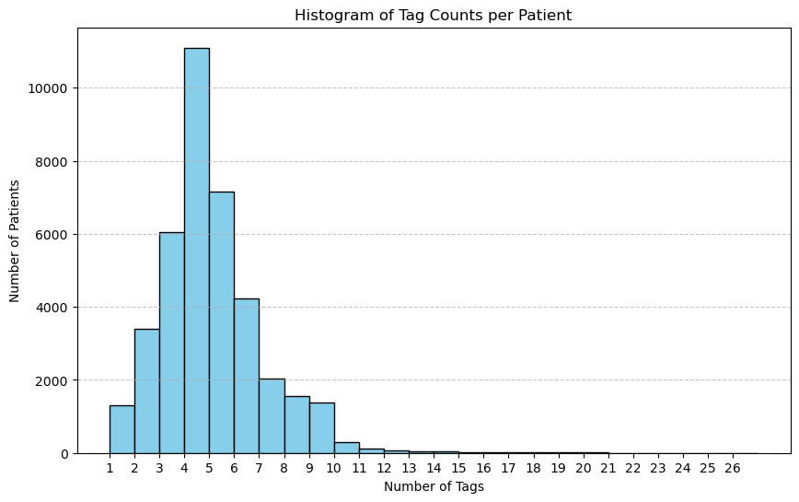
Tags as Predictor
Diagnosis (22 Conditions) Depression/Anxiety/Bipolar/ADHD/OCD/...
Modality (11 Approaches) CBT/DBT/Mindfulness/...
Other Demographics
Identify various categories and keywords associated with them.
Assign tags to these categories based on keyword matching.
Notes:
The tags were grouped into categories for common mental health conditions such as depression, anxiety, bipolar disorder, eating disorders, ADHD, etc. Additionally, tags were categorized based on treatment methods, including CBT, DBT, mindfulness, medication, and so on. I Identified over 400 diagnosis tags and 400 modality tags, however, there are over 5 thousand tags in total, the majority of them is not valuable to predictive model.
Here's how I did it: first, identify various tags and keywords associated with them.
Second, assign tags to these treatment groups based on keyword matching.
A significant challenge was ensuring that the tags were accurately grouped despite variations in wording and terminology. We are unable to confirm the use of many tags, since they are created by clinics/therapists, and different therapists/clinics may use them in different ways.
After merged tags data with patient table, the diagnosis column served as a complement for the diagnosis recognized by assessments to reduce the amount of missing value. The modality column is not included in the following analysis, b

Slide 19
Responses as Predictor
General Demographic (Most Frequency Questions)
- Age, Gender, Occupation, Mother Tongue, Ethnicity
Significant Behaviors (Big Clinic Questions)
- Suicide Attempt
- Violent Behaviour
- Deliberate Self-Harm
- Homicidal Threats
- Experiencing Violence
Notes:
I will discuss our approach to using response data as a predictor for TA score.
We begin by exploring the most frequently asked questions within our patient database, which primarily cover general demographic information such as date of birth, gender, occupation, mother tongue, and ethnicity.
The initial analysis of frequency questions helps us understand the basic composition of our patient population. To gain deeper insights into the psychological conditions, we analyzed the most common questions asked by the top 3 clinics.
Upon identifying these key behaviors, we extracted all relevant patient responses that matched these criteria. And then categorized the responses into binary outcomes (True/False). One of the challenges we met to deal with response data is diversity of questions asked across different clinics. When we attempt to extract data based on these Significant Behaviors keywords, the results are notably limited.

Slide 20
THERAPEUTIC_ALLIANCE_SCORE | Numeric score quantifies therapeutic relationship between a therapist and their patient
PATIENT_TYPE | Binary variable indicates whether the patient is Adult or Child
INOFFICE | Boolean value indicates whether the patient's sessions are conducted in person
SUICIDALITY_FLAG | Boolean value indicates whether the patient has suicidal tendencies
AVERAGE_INITIAL_SCORE | Numeric value calculated average patient initial assinged assessment
COMPLETED_RATIO | Numeric value calculated assessment completed ratio
DIAGNOSIS | Categorical variable classified patients diagnosis into 12 groups
Age | Integer value calculated ages between 0-100
Gender | Categorical variable classified Female, Male or Other
Occupation | Categorical variable classified into 9 groups
Response Variable
Notes:
This chart descripts all the variables we use for modelling so far.
We predict the Therapeutic Alliance Score as our continuous response, is a numeric...

Slide 21
Variable Description continue...
DIAGNOSIS | Anxiety | Depression | Anxiety_Depression | PTSD | Addiction | Eating Disorder | Personality | OCD | ADHD | Postpartum | Abuse | Dissociation
Levels | 0 | 1 | 2 | 3 | 4 | 5 | 6 | 7 | 8 | 9 | 10 | 11
Occupation | Other | Professional Services | Health Care | Student | Unemployed | Education | Manufacturing and Construction | First Responder | Administrative and Support Services
Levels | 0 | 1 | 2 | 3 | 4 | 5 | 6 | 7 | 8

Slide 22
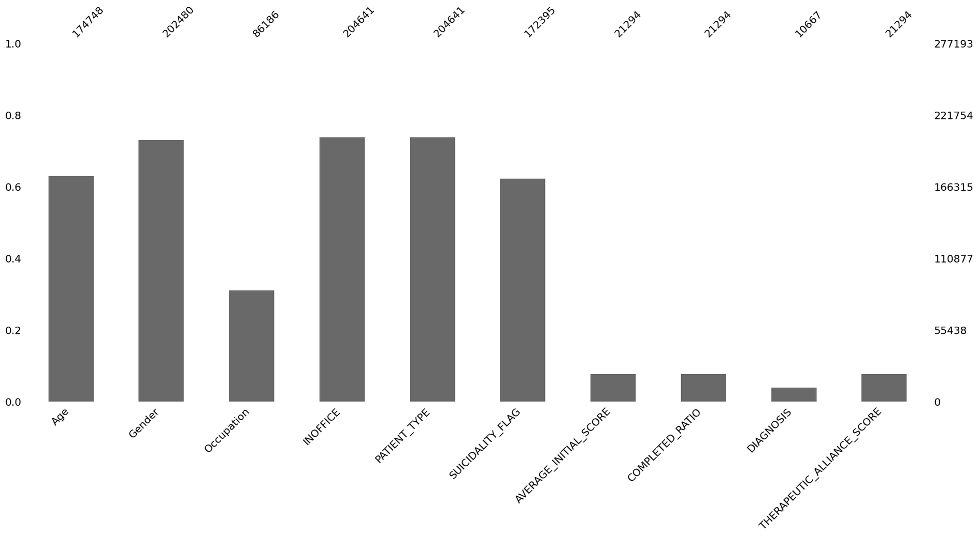
Count of rows
Notes:
Among 10 columns, there are only 21 thoudsand non-values for the TA score. So we remove all the rows where TA score are missing, since TA score it's our response variable, we would use these 21,294 rows for modelling.

Slide 23
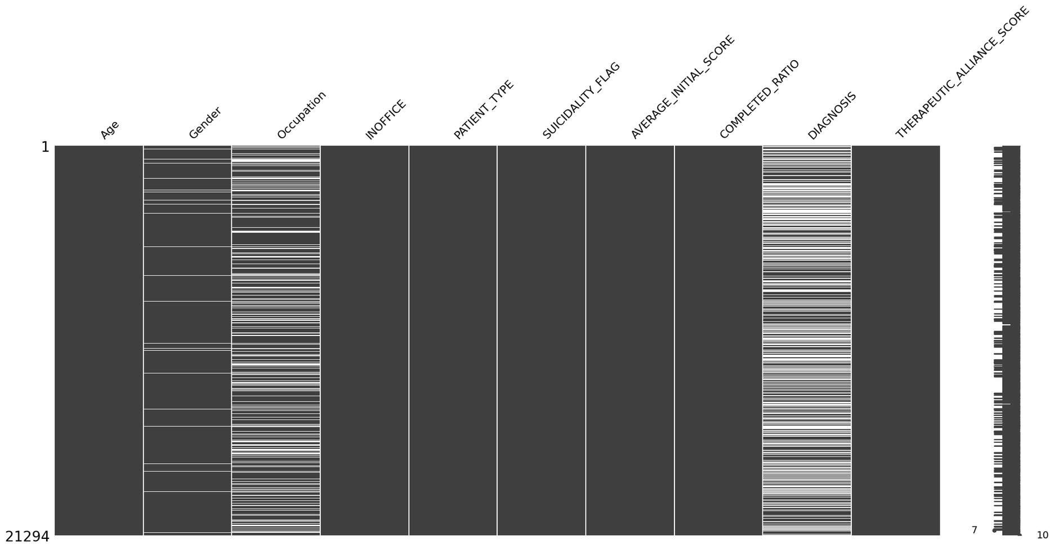
Missing Data (NAs)
Removed NAN THERAPEUTIC_ALLIANCE_SCORE
Unrecorded Data
Notes:
The reason that causing lots of the TA scores is the scores came from some specify assessments likes BR-WAI, might not have this data for patients without assined those assessment.
Besides, missing data in the gender and occupation columns occur when these specifics are not included in the questions answered by patients by any consideration.
Since the diagnosis information got from the most frequently given assessments for each patients, if the assessments that typically include diagnosis information are not completed, this leads to missing entries.

Slide 24
Models & Results
Notes:
OK, next im gonna introduce the models and results. In total, we had 3 relatively trials on different models and feature selections. I’m gonna introduce those 3 stages one by one.

Slide 25
Different Feature Selections Model Result
Stage 1
Initial_Assessment_Score, Assessment code -> TA Score
Linear Regression
Random Forest
MSE: 250.20
R Squared: 0.160
Adjusted R Squared: 0.159
MSE: 262.08
R Squared: 0.12
Adjusted R Squared: 0.12
Notes:
The first stage, we did at the second week since project started. This is the very first trial, we use the linear regression model and random forest model. And used initial assessment score and code only to predict the score. The result were pretty pad. None of them can achieve the adjusted R squared higher than 16%. In comparison, the linear regression model performs even a little better than random forest. After this stage, we thought that the bad performance could primarily because of not enough features. Only two features, initial assessment score and code are not enough and not informative to handle the predictions.

Slide 26
Different Feature Selections Model Result
Patient Age, Gender, Occupation, Mother Tongue, Ethnicity, Suicide Attempt, Violent Behaviour, Deliberate Self-Harm, Homicidal Threats, Experiencing Violence, Completed Assessment Ratio, Tag
-> TA Score
Stage 2
Random Forest
Ridge Regression
Lasso Regression
MSE: 262.35
R Squared: 0.098
Adjusted R Squared: 0.097
MSE: 285.12
R Squared: 0.019
Adjusted R Squared: 0.019
MSE: 286.35
R Squared: 0.015
Adjusted R Squared: 0.014
Decision Tree
Linear Regression
MSE: 279.49
R Squared: 0.039
Adjusted R Squared: 0.038
MSE: 250.20
R Squared: 0.160
Adjusted R Squared: 0.159
Notes:
So in stage 2, we tried to extract more information from the open-ened questions and answers from the dataset, and label the patients with Age, Gender, Occupation, Mother Tongue, Ethnicity, Suicide Attempt, Violent Behaviour, Deliberate Self-Harm, Homicidal Threats, Experiencing Violence, Completed Assessment Ratio, Tag, etc.
This step costs huge amount of time because it’s really hard to organzie those open-ended answers. We had highly hope on this feature selections. We tried random forest, ridge regression, lasso regression, decision tree and linear regression. However, none of them could make even 15% more adjusted R squared. As we introduced before, this is because of the numerous existent of null values. Not all clinics will ask and not every patient is gonna answer if they have those mental illness before.

Slide 27
Different Feature Selections Model Result
Patient Age, Gender, Occupation, Initial_Assessment_Score_AVG, INOFFICE, PATIENT_TYPE, SUICIDALITY_FLAG, COMPLETED_RATIO, DIAGNOSIS
-> TA Score
Stage 3
(Current Stage)
Random Forest
(NaN filled by most_frequent value)
Random Forest
(Row dropped if NaN)
Lasso + Random Forest Regression
MSE: 192.772
R Squared: 0.32
Adjusted R Squared: 0.31
MSE: 220.18
R Squared: 0.20
Adjusted R Squared: 0.19
MSE: 222.38
R Squared: 0.198
Adjusted R Squared: 0.191
Notes:
We failed in this stage because of the null values, so next what we did is try to avoid using features that are full of null values. At current stage, we only used Age, Gender, Occupation, Initial_Assessment_Score_AVG, INOFFICE, PATIENT_TYPE, SUICIDALITY_FLAG, COMPLETED_RATIO, DIAGNOSIS these nine featues as input. All those features are fairly completed. Among all models we tried in this stage, the random forest with null values filled by most_frequent values stand out, with adjusted R squared above 30%. Although this cannot be saying as a good result, it is way better than previous trials.

Slide 28
Summary
Fail to identify useful predictors for TA
Complicated nature of TA
therapist factors
treatment factors
relationship factors
Weakness of this dataset
lots of open-ended questions
tailored tags and questions by every clinic
lots of missing data
lack of therapist demographic
Notes:
In summary, at current stage, we are not yet successfully to predict the TA score with useful features. We believe this can be some reasons from the dataset. According to the literature review, the TA score is a complicated thing, it is not only depend on the patient but also depends on the therapist, the treatment, and the relationship between the patient and therapist. Our dataset in this scenatio is a little bit restricted. There are so many open-ended questions and answers varied by the clinics, and the data is often missing with null values. More importantly, we only have the patient information but are lack of the therapist demographic information.

Slide 29
Next Steps
Therapist Match
which therapists is seeing improvement for patients of a specific assessment
Other Ｍatch Logic
high average TA (therapeutic alliance score)
high average TA of clients with similar characteristics
low caseload
improvement within 6 sessions with patients of similar characteristics
success with 5 similar patients based on their clinical outcomes

Slide 30
Thank you!

